Slide 1






Smarter Employment Decisions

Slide 2
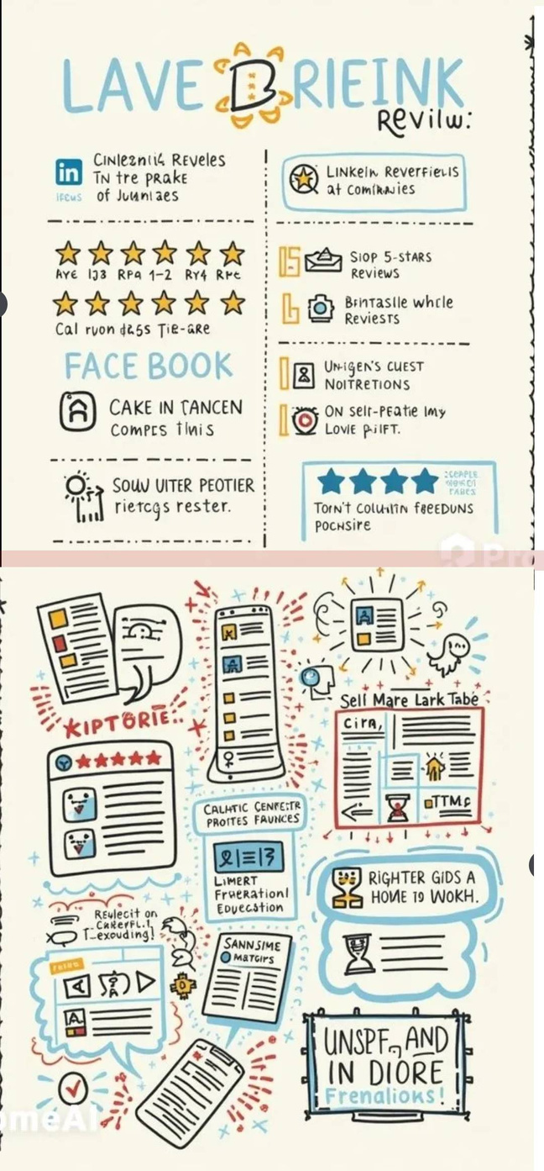
PROJECT OVERVIEW
Verified Insights for Smarter Hiring
Content:
Problem: Employment platforms like LinkedIn and Indeed rely on self-praise, offering biased or incomplete information about companies and candidates.
Solution: InsightScope delivers verified, insights on companies and employees, empowering job seekers and employers to make data-driven decisions.
Value Proposition: Revolutionizes hiring and job-seeking with transparent, reliable feedback.

Slide 3



Gap analysis
Current State
(Before InsightScope)
Desired Future State (After InsightScope)
Identified Gap

Slide 4
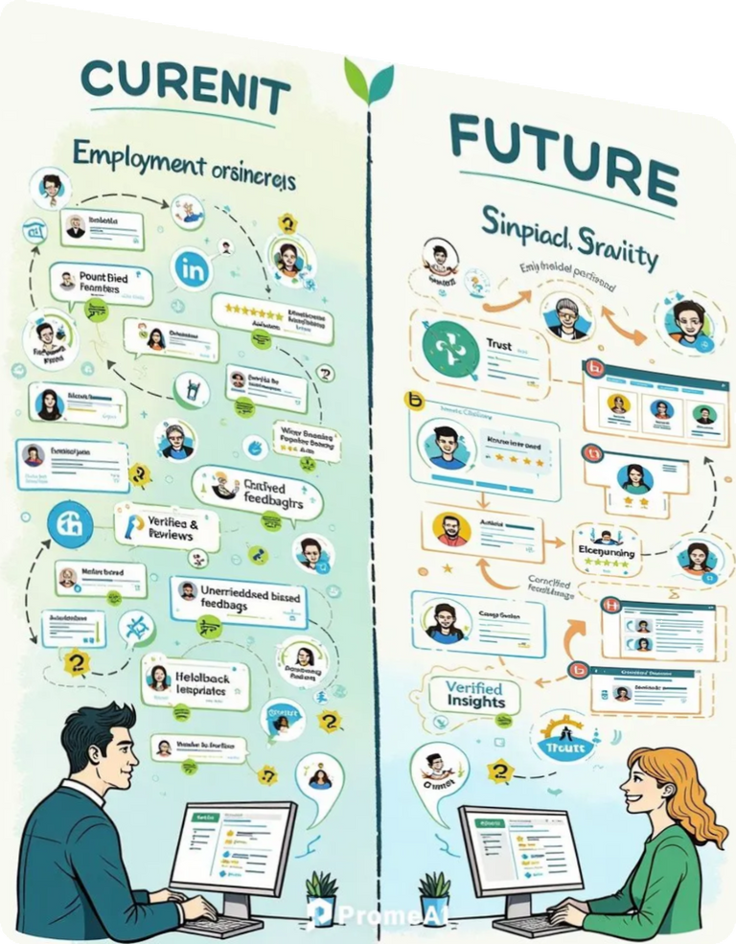
Gap analysis
Current State
(Before InsightScope)
The Problem with Current Platforms
Unverified Reviews: Feedback on platforms like LinkedIn is often biased, manipulated, or inaccurate.
Lack of Transparency: Job seekers and employers can’t trust the data, leading to poor decisions.
Impact: Employers make bad hires, and job seekers end up in unsuitable places.
Turning to Unreliable Sources: For real information, users often turn to unprofessional platforms like Facebook, which are full of unverified claims and misleading content.

Slide 5
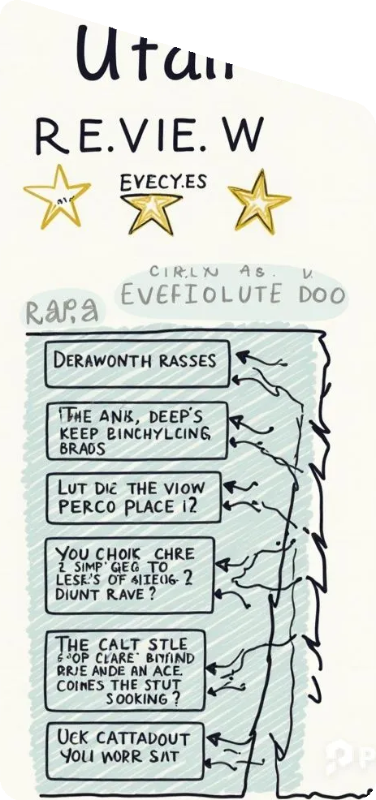
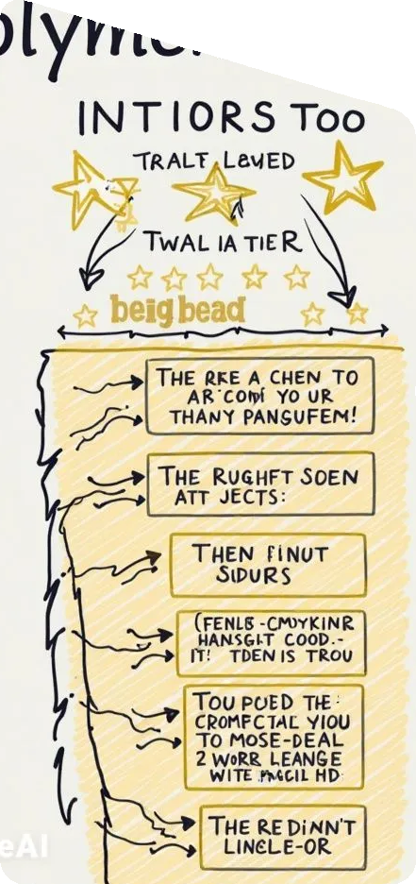
Gap analysis
Identified Gap
No Real-Time Feedback: No platform offers verified, multi-source feedback integrated into job search platforms.
Users Need Trustworthy Data: Both job seekers and employers lack reliable tools to trust the information they’re seeing.
Mismatched Decisions: Job seekers fall into unsuitable roles, and employers are misled by overrated resumes. InsightScope closes this gap by providing verified, trustworthy insights, making the job market more transparent.
Critical Need: Without verified insights, companies and candidates continue making decisions based on incomplete or false information.

Slide 6

Gap analysis
Desired Future State (After InsightScope)
Verified Feedback System: Multi-source, real-time verified insights for job seekers and employers.
Basic Insights Without Leaving the Platform: Users get instant, verified feedback while browsing on LinkedIn and Indeed, without needing to switch platforms.
Improved Decision-Making: InsightScope enables better hiring decisions and higher job satisfaction by offering trusted data.
Seamless Integration: InsightScope works directly on LinkedIn and Indeed, offering feedback without disruption.

Slide 7
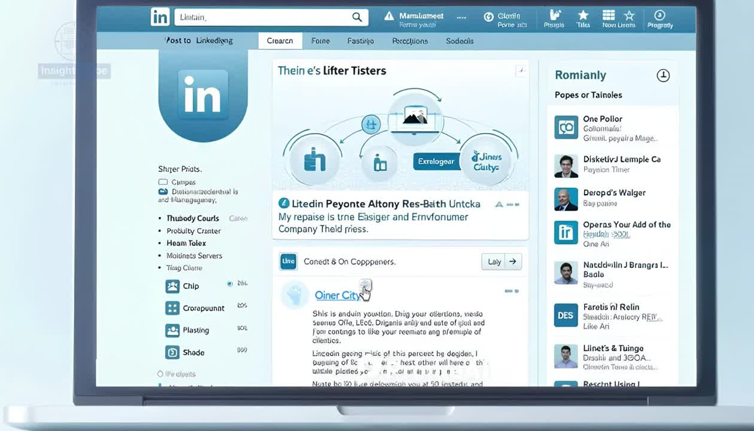

Slide 8














Business Model
(Revenue streams)
1
2
3
4
Freemium Model:
Free basic features with paid access to premium insights and analytics.
(For natural spreading)
Company Subscriptions:
Charge companies for access to verified reviews and analytics.
Sponsored Individuals and Company Profiles
Data Licensing:
Sell anonymized data to HR firms and recruitment agencies.

Slide 9







PROJECT CHARTER
Objective
01
Develop a browser extension compatible with LinkedIn, Indeed, and other employment websites.
02
Create a website to host profiles for companies and employees,
providing insights through verified feedback.
03
Launch a feedback system for companies and employees, verified by Multiple data points to ensure fairness.
04
Successfully targeted companies in Egypt for a soft launch, focusing on established, larger organizations.

Slide 10




PROJECT CHARTER
High-Level Requirements
1
2
3
4
The browser extension must integrate seamlessly with LinkedIn, Indeed, and other employment platforms.
The website must support detailed profiles for companies and employees, and display verified feedback
A moderation and verification system must be in place to prevent biased feedback.
The platform must ensure cross-browser compatibility and support all major browsers (Chrome, Firefox, Safari, etc.).

Slide 11





Project Manager and Authority Level
Summary Milestone Schedule
MONTH 1
Finalize project requirements and gather user stories. Begin design work for the extension and website.
AYMAN IDRIS
PROJECT MANAGER
MONTHS 2-3
Full development of the browser extension, feedback system, and website.
Authority Level
coordinates teams, manages risks, and ensures timelines are met. They have the authority to assign tasks, manage resources, and approve changes throughout the project.
MONTH 4
Testing, quality assurance, and GDPR compliance checks. Execute the soft launch with key companies in Egypt..

Slide 12


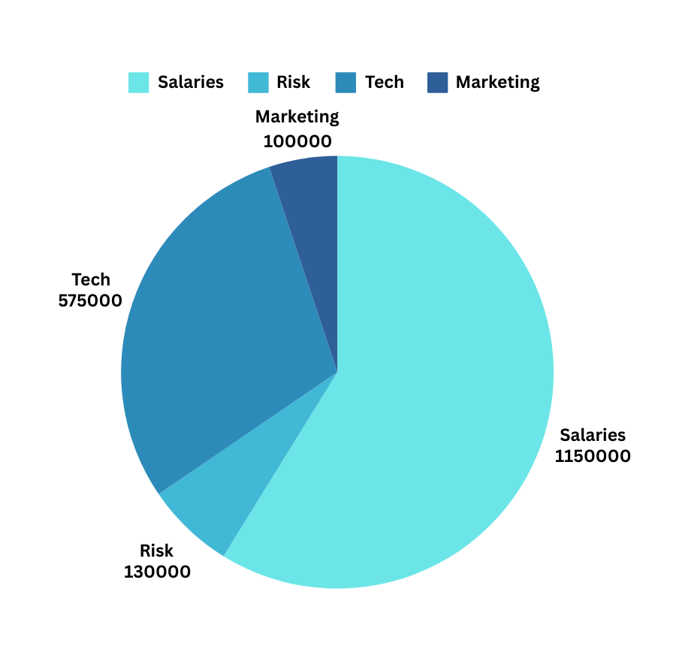

PROJECT CHARTER
SUMMARY BUDGET
Total Project Budget
EGP 1,610,000 - 1,955,000
Sponsor: Ministry of Communications
and Information Technology

Slide 13





















Ministry of Communications and Information Technology
01
Moderation & Markting Team
06
Government , Sponsor , Successful delivery and alignment with national objectives
Moderators/ Marketing & User Acquisition Specialists - Efficient tools to manage biased or malicious feedback / Clear guidance on features, promotional resources
02
Job Seekers
Testing Team
07
LinkedIn/indeed users , - Transparent, reliable, and verified feedback - Company insights, feedback transparency
STAKEHOLDERS
REGISTER
QA Engineers - Access to development environment for thorough testing - System functionality and performance
03
Companies
Development Team
08
LinkedIn/indeed users - Verified feedback on potential employees -
Employee insights, feedback accuracy
Developers,Engineers,UX/UIDesigners Transparent,reliable,and verified feedback-Extension and website development
04
Product owner
Target Companies in Egypt
09
Project Team - Ensure product backlog is prioritized and aligned with project goals. - Backlog refinement, sprint planning, and user story clarification.
I.T and Tech. companies in Egypt -Pilot participants - Usable system with accurate insights on employee feedback - Usability and feedback accuracy
05
Project Manager
Browser Extension Platforms
10
Project Team - (scrum master) - Delivery within scope, budget, and schedule - Planning, execution, risk management
Chrome, Firefox, Safari - Platform providers - Secure and compatible extension - Platform security and performance

Slide 14

Product Backlog

Slide 15
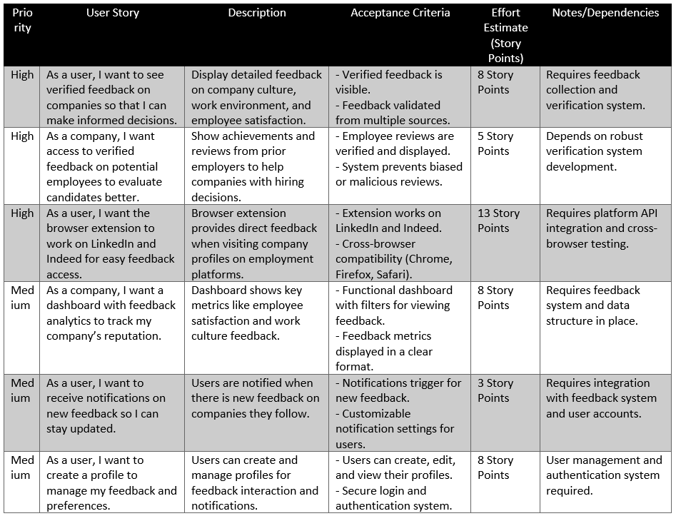

PRODUCT BACKLOG

Slide 16
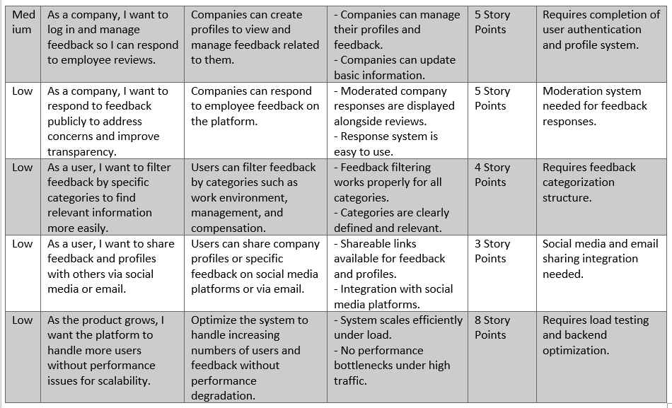
PRODUCT BACKLOG

Slide 17



EPIC GRAPH
Insight Scope
Feedback System
User Profiles
Notifications
Feedback Sharing
1-user,verified feedback on companies
2-company,verified feedback on potential employees.
3-user,browser extension to work on LinkedIn.
1-user,create a profile
2-company,respond to employee reviews.
3-company,track my company’s reputation.
1- user, receive notifications on new feedback
2-company, respond to feedback
3-user,filter feedback
1- user, share feedback and profiles
2-handle more users
Place
order!

Slide 18


Slide 19




SPRINT 01 OVERVIEW
Sprint Duration (2 weeks)
Deliverables
Total Tasks
Start date: 12/09/24
End date: 03/10/24
Feedback System
11 Task
user stories:
Verified feedback on companies
access to verified feedback on potential employees.
the browser extension to work on LinkedIn for easy feedback access.
Cost
395,000 EGP

Slide 20
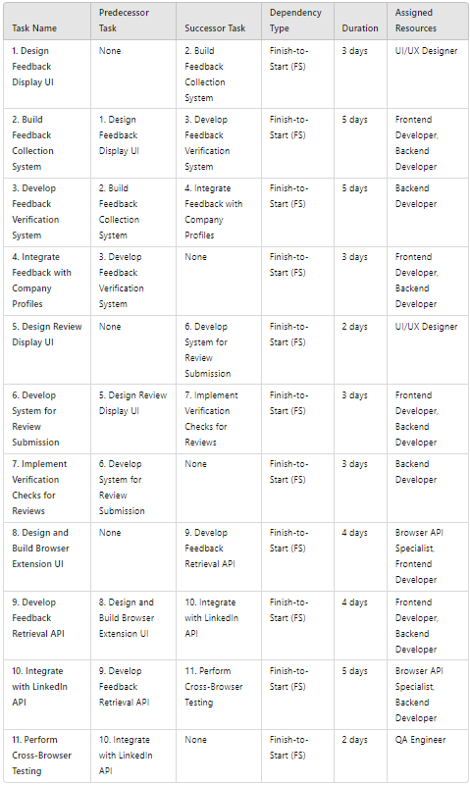
TASK DEPENDENCIES FOR SPRINT 1

Slide 21
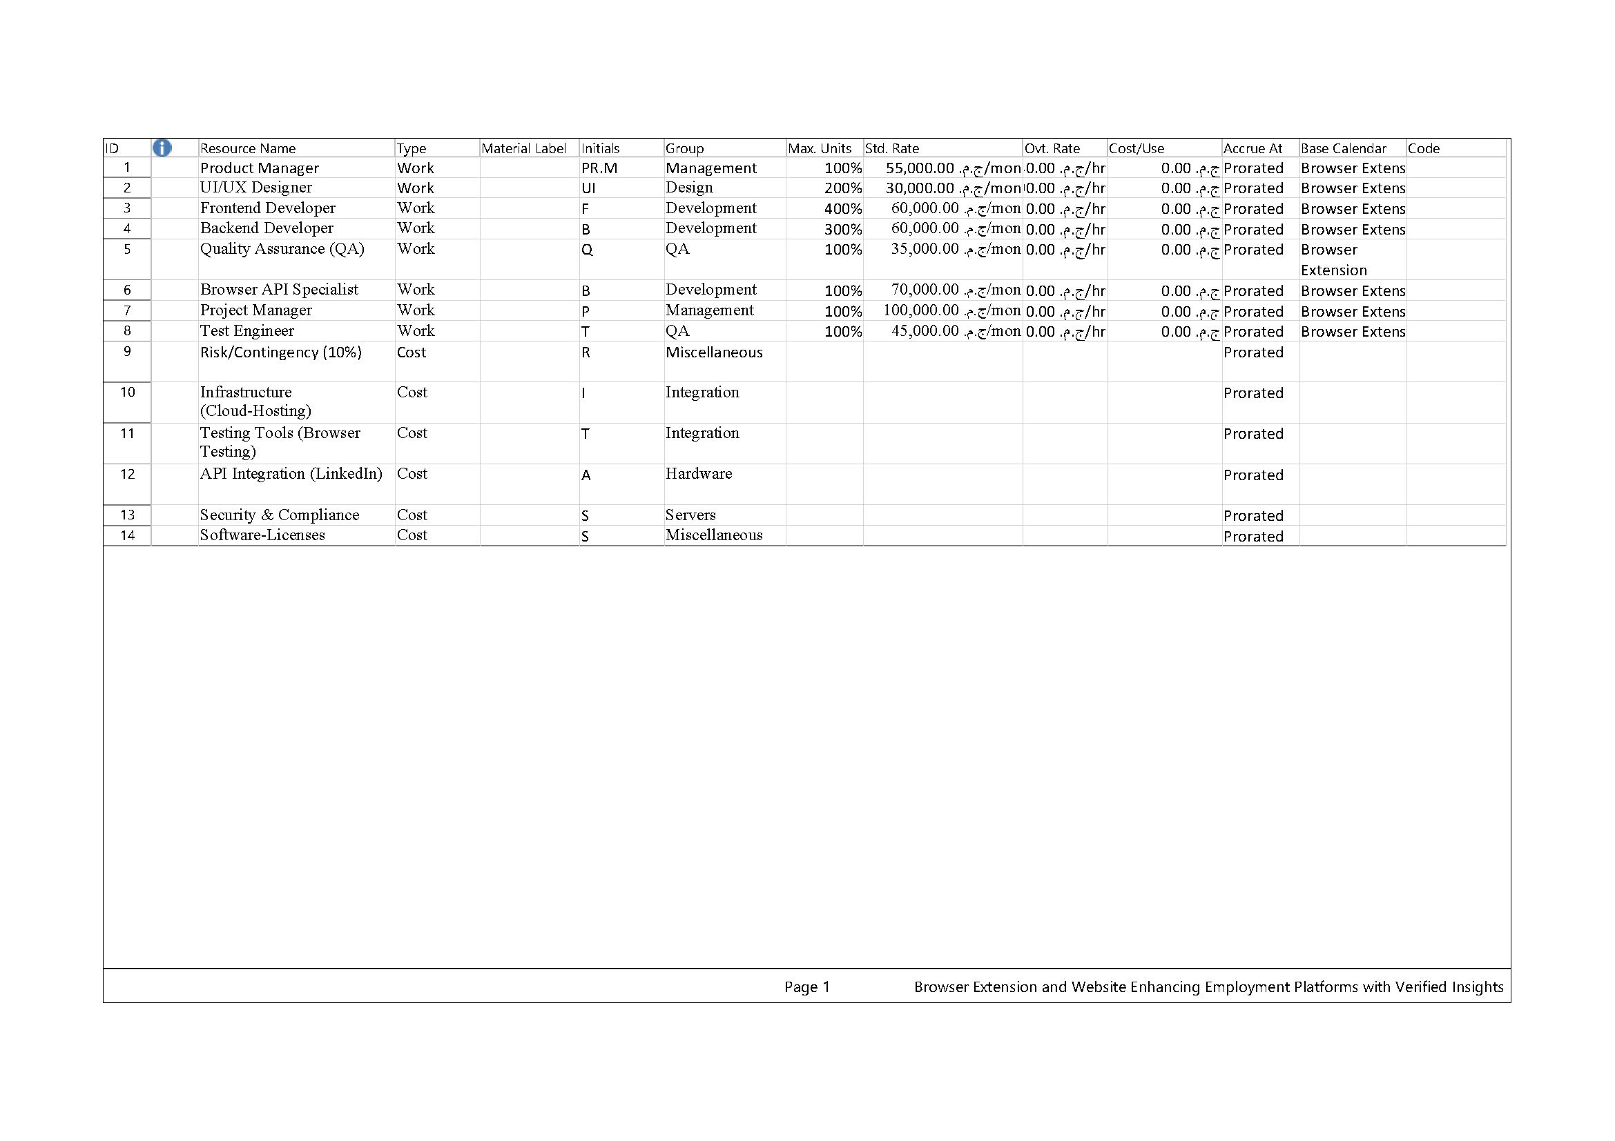
RESOURCE SHEET

Slide 22
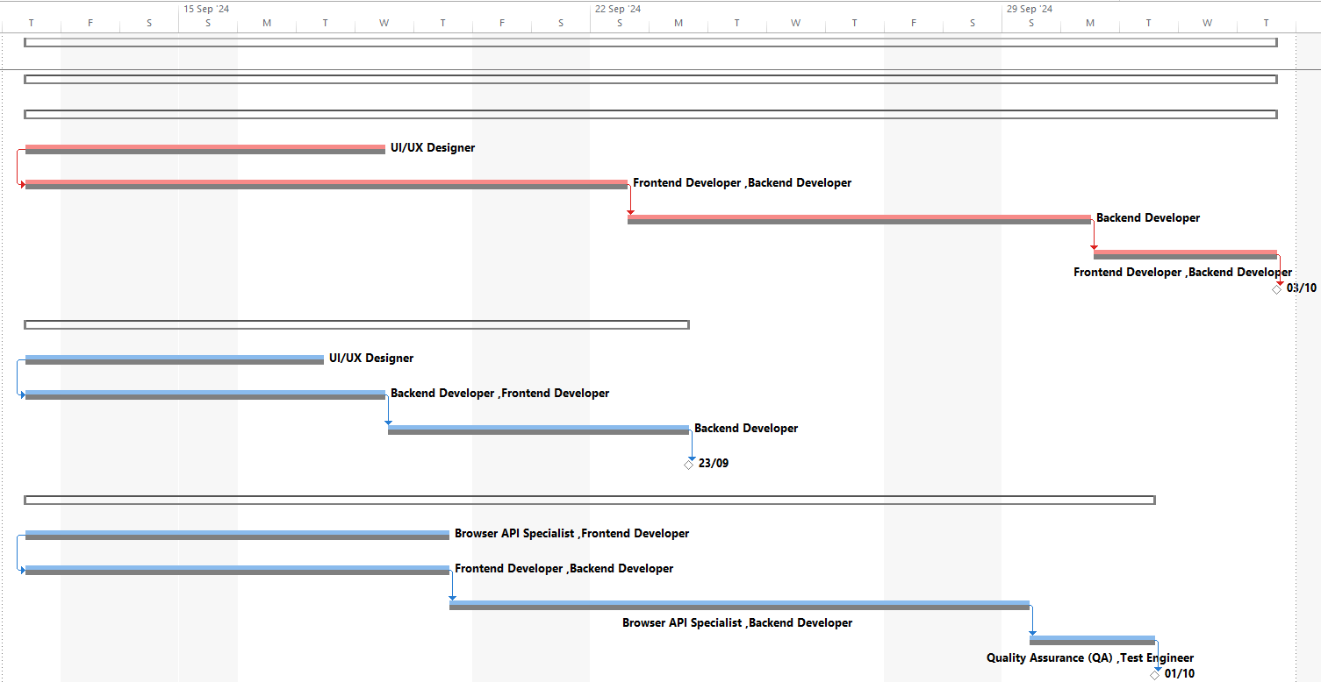
GHANT CHART BASELINE

Slide 23
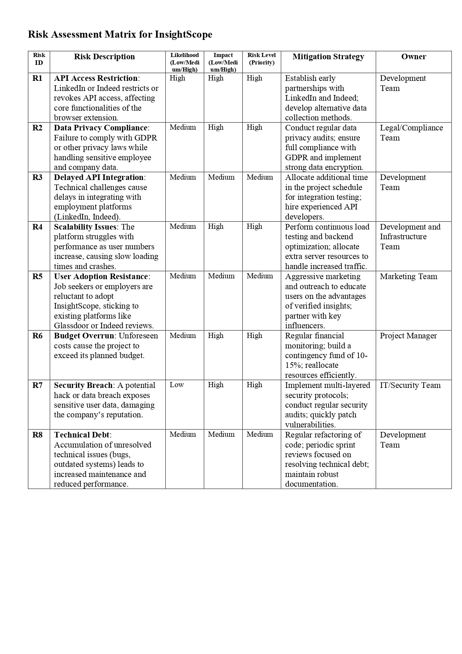
Risk Assessment Matrix for InsightScope

Slide 24
Date: 26-9-2024
Project: InsightScope
Attendees
Daily Standup Report
Product Manager (PM)
UI/UX Designer
Front-end Developer
Backend Developer
Quality Assurance (QA)
Quality Control (QC)

Slide 25
1. Product Manager (PM)
* Yesterday: Finalized user stories for the next sprint and conducted a stakeholder meeting.
* Today: Will prioritize the backlog and review feedback from the team.
* Blockers: Awaiting final approval on user stories from stakeholders
2. UI/UX Designer
* Yesterday: Completed wireframes for the new feature and started creating high-fidelity mockups.
* Today: Will present mockups to the team for feedback and make necessary adjustments.
* Blockers: Need clarification on some user requirements from the PM.
Updates
3. Front-end Developer
* Yesterday: Integrated the new design into the application and fixed a few bugs in the existing codebase.
* Today: Will start implementing responsive design for mobile devices.
* Blockers: Encountering issues with cross-browser compatibility.

Slide 26
4. Backend Developer
* Yesterday: Set up the database schema for the new feature and created API endpoints.
* Today: Will work on connecting the API with the front-end and writing tests for the endpoints.
* Blockers: Need assistance with API documentation.
5. Quality Assurance (QA)
* Yesterday: Conducted initial testing on the latest build and reported bugs to the dev team.
* Today: Will continue testing new features and prepare a test plan for the upcoming release.
* Blockers: Some critical bugs need immediate attention from developers.
Updates
6. Quality Control (QC)
* Yesterday: Reviewed test cases and documentation to ensure compliance with standards.
* Today: Will perform a quality review of the current build and provide feedback to the team.
* Blockers: None at this time.

Slide 27
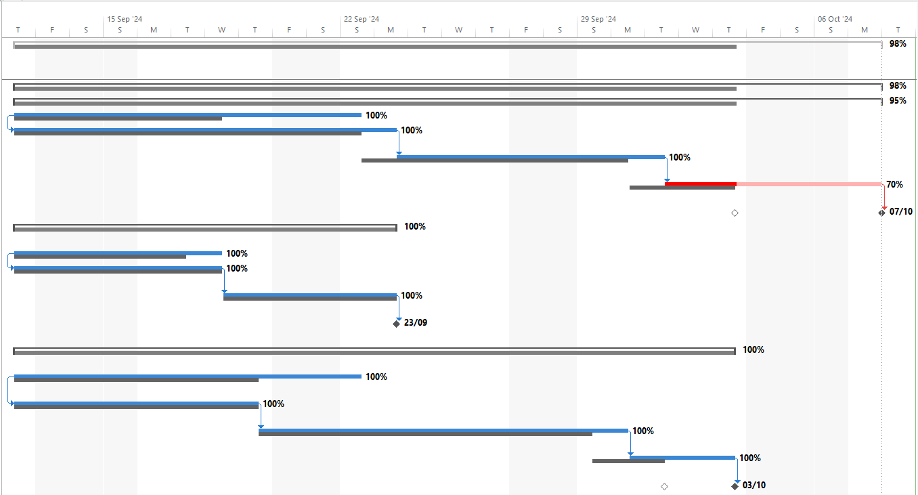
GHANT CHART ACTUAL

Slide 28
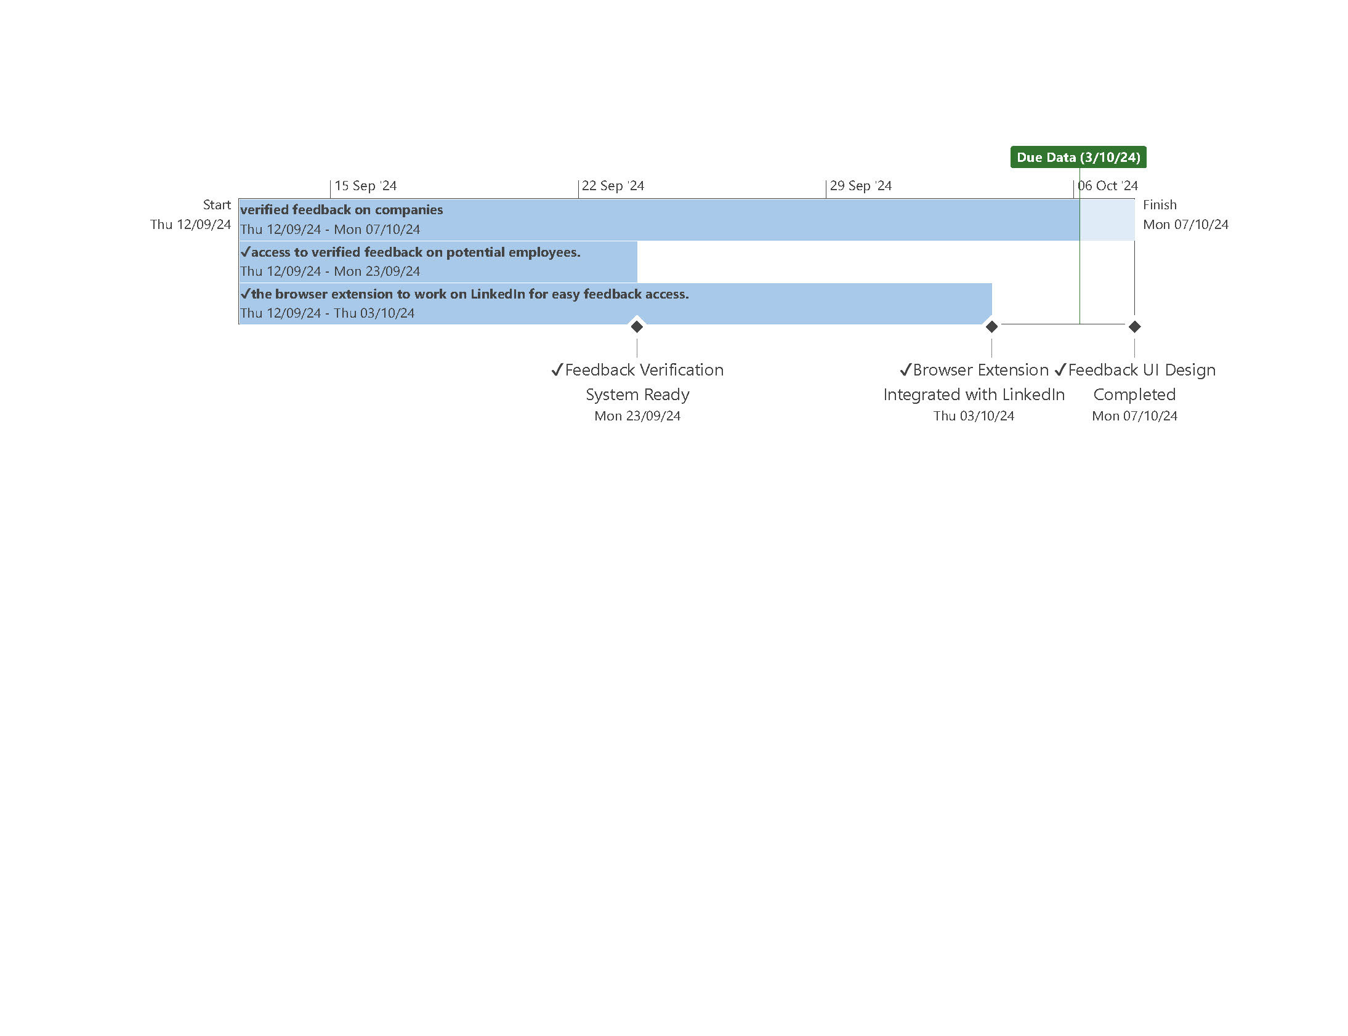
TIMELINE

Slide 29
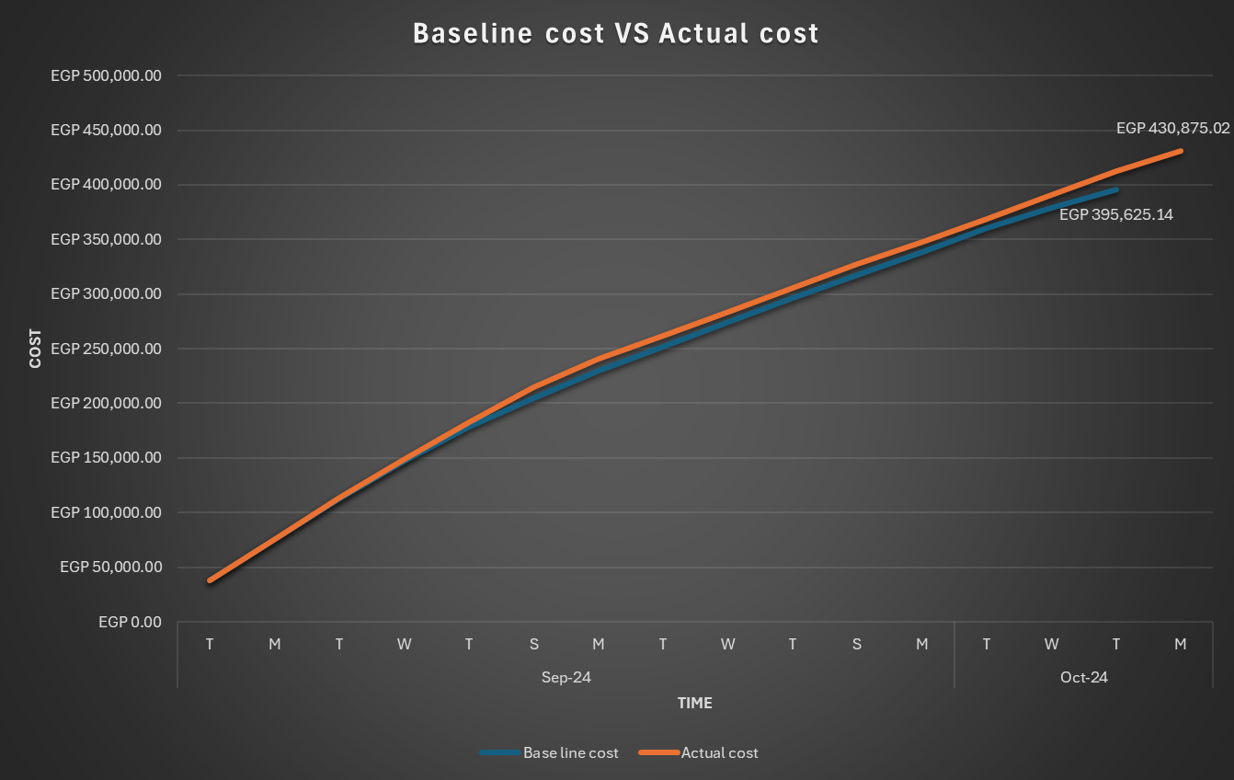

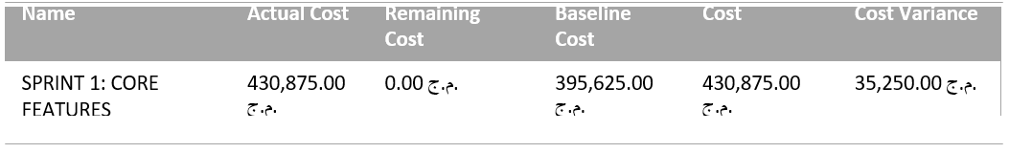
S-CURVE

Slide 30
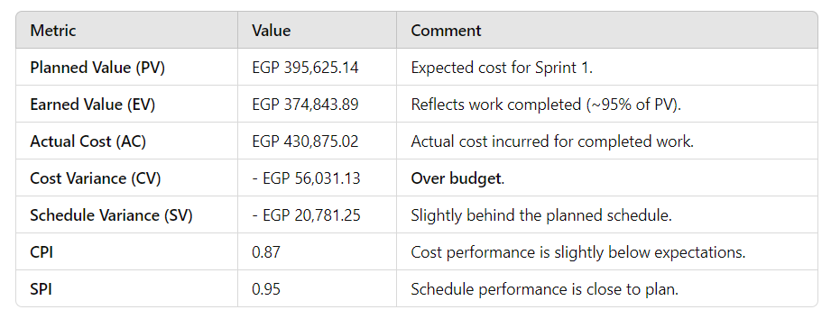
EARNED VALUE ANALYSIS (SUMMARY)

Slide 31
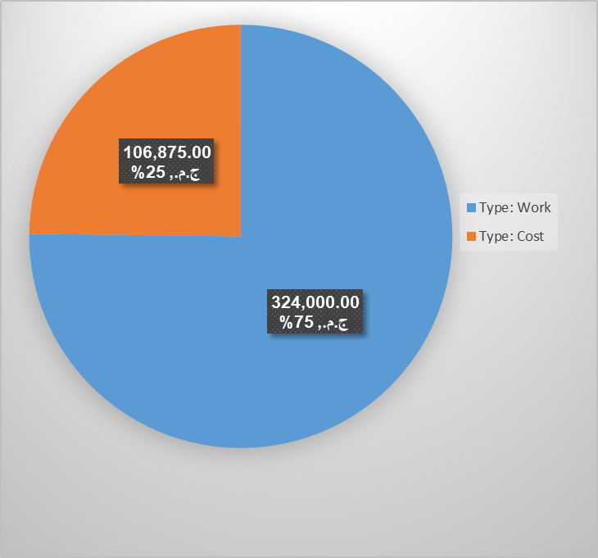
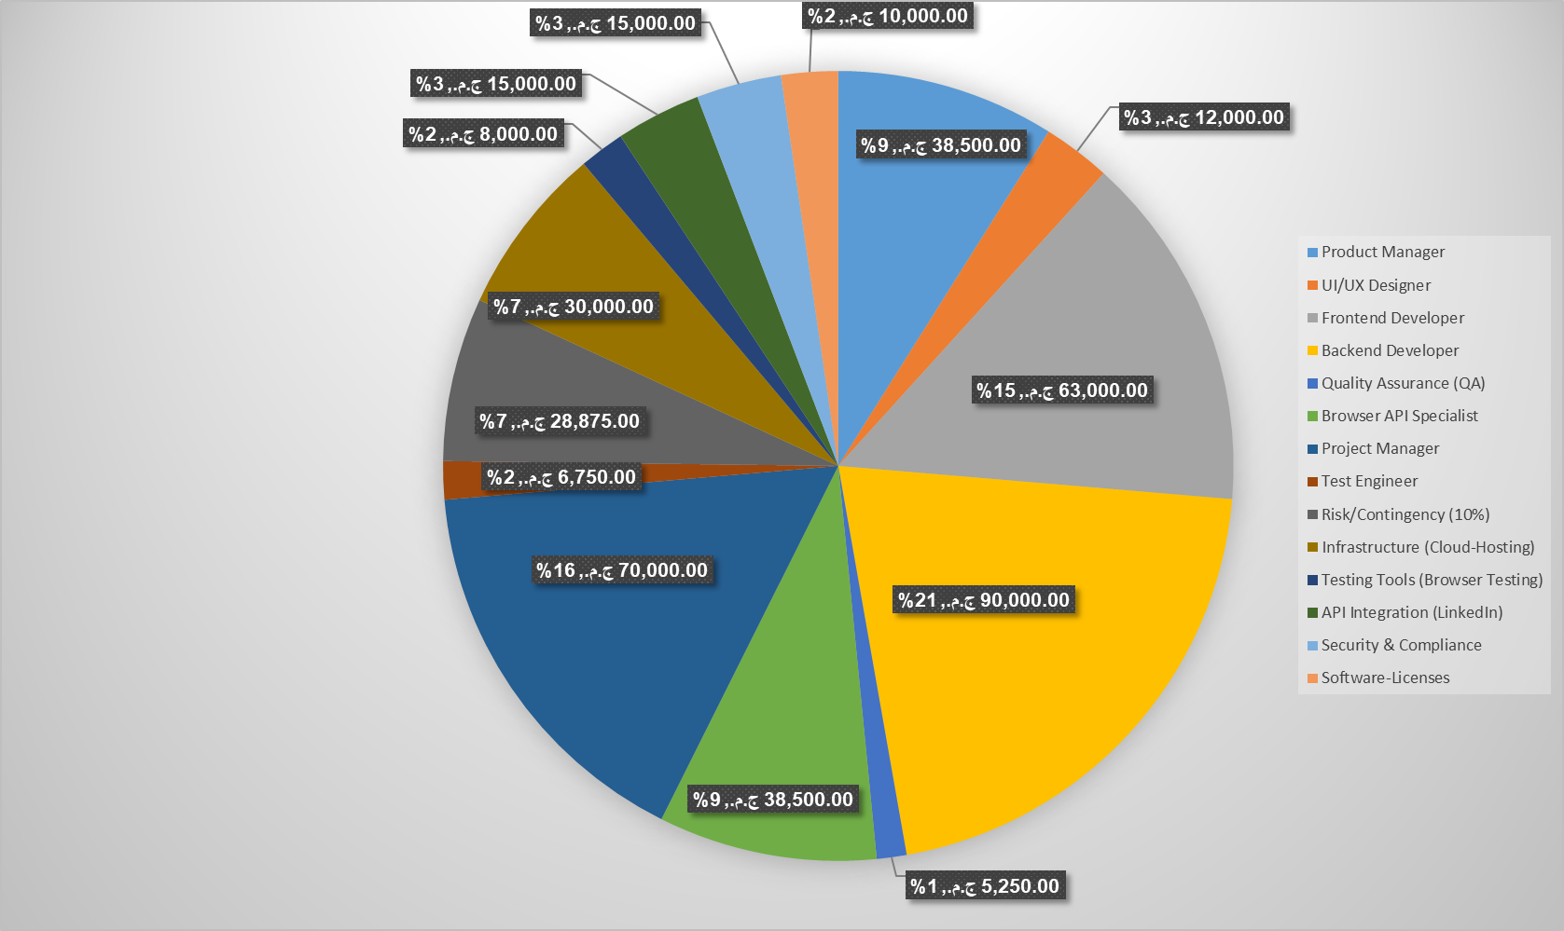
COST DISTRIBUTION

Slide 32
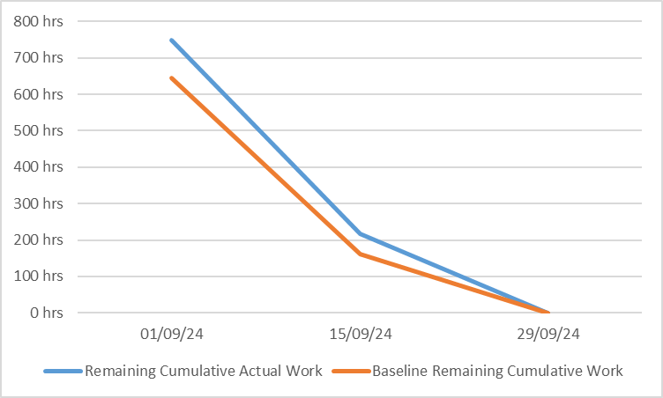
BURNDOWN CHART

Slide 33




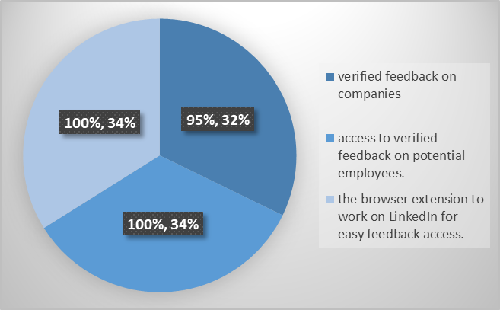

SPRINT REVIEW
COMPLETED USER STORIES
KEY SUCCESSES:
Verified feedback on companies-95%
access to verified feedback on potential employees - 100%.
the browser extension to work on LinkedIn for easy feedback access - 100%.
Access to Verified Feedback on Employees and the Browser Extension for LinkedIn were fully completed and tested.
CHALLENGES
The Verified Feedback on Companies story was only 70% completed due to complexity in integrating verified feedback data from multiple sources.

Slide 34


RETROSPECTIVE SUMMARY
WHAT WENT WELL?
WHAT COULD BE IMPROVED?
95% completion of planned story points, with the Browser Extension and Employee Feedback features delivered as scheduled.
More time should be allocated to complex features like Verified Feedback on Companies, especially in areas requiring data integration from multiple sources.

Slide 35


NEXT STEPS
OUTSTANDING WORK FOR SPRINT 1:
PREPARATION FOR SPRINT 2:
Complete the remaining 5% of the Verified Feedback on Companies user story.
Refocus resources on delivering User Profile Management and Dashboard Analytics.
Carry over the unfinished portion of the Verified Feedback on Companies feature into Sprint 2 and address the integration challenges early.

Slide 36
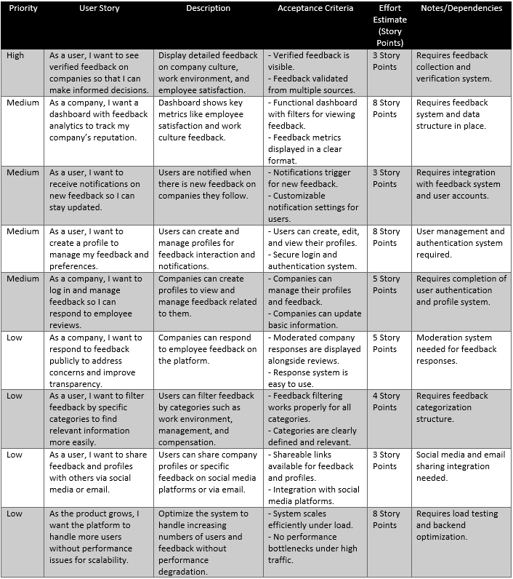
UPDATED BACKLOG

Slide 37
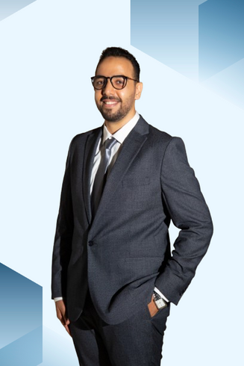
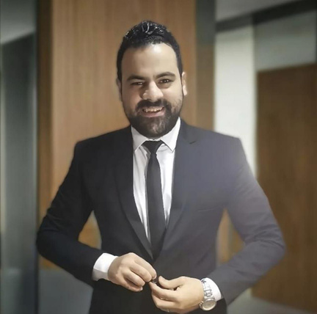
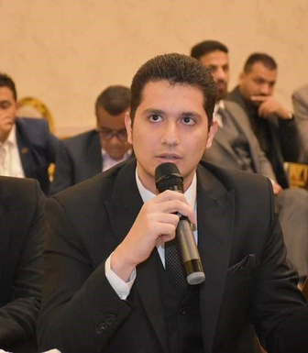


OUR TEAM
AYMAN
IDRIS
MOSTAFA
EID
AHMED
HOTER
Ceo Of Ingoude Company
Ceo Of Ingoude Company
AHMED
ABDEEN
GEHAD
NASSER
AFNAN
ELZAWAHRY

Slide 38

THANK'S FOR YOUR TIME AND ATTENTION
Any Questions?

